Slide 1
Software Engineering
Prepared by: Neha Tripathi

Slide 2
Agile Software Development
eXtreme Programming(XP)
Scrum

Slide 3
Rapid software development
Rapid development and delivery is now often the most important requirement for software systems
Businesses operate in a fast –changing requirement and it is practically impossible to produce a set of stable software requirements
Software has to evolve quickly to reflect changing business needs.
Rapid software development
Specification, design and implementation are inter-leaved
System is developed as a series of versions with stakeholders involved in version evaluation
User interfaces are often developed using an IDE and graphical toolset.

Slide 4
Agile methods
https://www.youtube.com/watch?v=BqIOPa-kbLE
Dissatisfaction with the overheads involved in software design methods of the 1980s and 1990s led to the creation of agile methods. These methods:
Focus on the code rather than the design
Are based on an iterative approach to software development
Are intended to deliver working software quickly and evolve this quickly to meet changing requirements.
The aim of agile methods is to reduce overheads in the software process (e.g. by limiting documentation) and to be able to respond quickly to changing requirements without excessive rework.

Slide 5
Agile manifesto
We are uncovering better ways of developing software by doing it and helping others do it. Through this work we have come to value:
-Individuals and interactions over processes and tools -Working software over comprehensive documentation -Customer collaboration over contract negotiation -Responding to change over following a plan
That is, while there is value in the items on the right, we value the items on the left more.

Slide 6
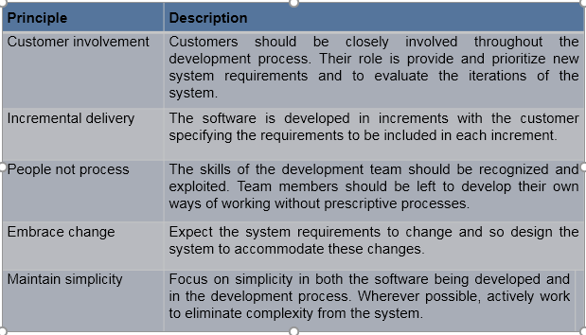
The principles of agile methods

Slide 7
Agile method applicability
Product development where a software company is developing a small or medium-sized product for sale.
Custom system development within an organization, where there is a clear commitment from the customer to become involved in the development process and where there are not a lot of external rules and regulations that affect the software.
Because of their focus on small, tightly-integrated teams, there are problems in scaling agile methods to large systems.

Slide 8
Problems with agile methods
It can be difficult to keep the interest of customers who are involved in the process.
Team members may be unsuited to the intense involvement that characterizes agile methods.
Prioritizing changes can be difficult where there are multiple stakeholders.
Maintaining simplicity requires extra work.
Contracts may be a problem as with other approaches to iterative development.

Slide 9
Plan-driven and agile development
Plan-driven development
A plan-driven approach to software engineering is based around separate development stages with the outputs to be produced at each of these stages planned in advance.
Not necessarily waterfall model – plan-driven, incremental development is possible
Iteration occurs within activities.
Agile development
Specification, design, implementation and testing are inter-leaved and the outputs from the development process are decided through a process of negotiation during the software development process.

Slide 10
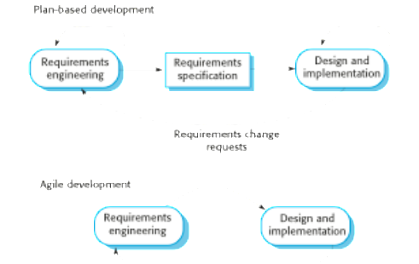
Plan-driven and agile specification

Slide 11
Agile Methods
eXtreme Programming(XP)?
Scrum ?

Slide 12
Thank You!

